Slide 1
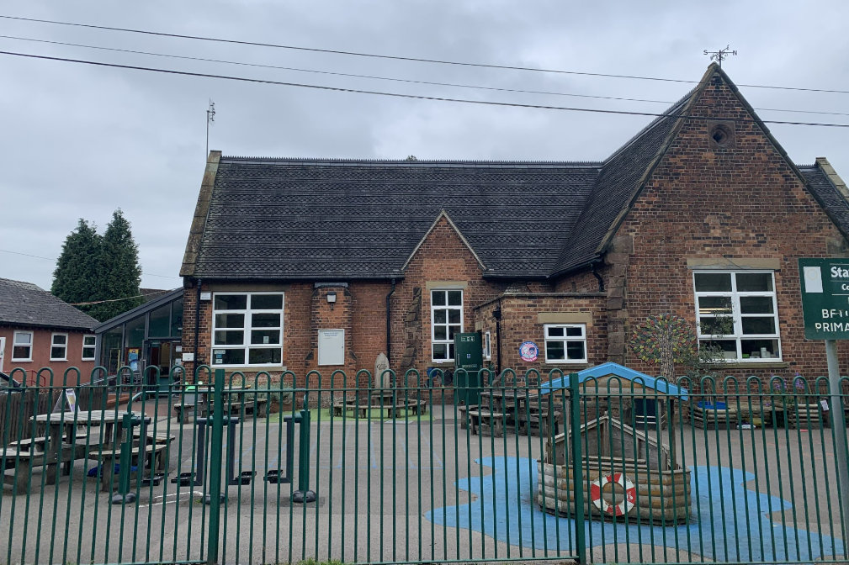


Welcome to Betley CE Primary School

Slide 2
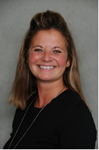
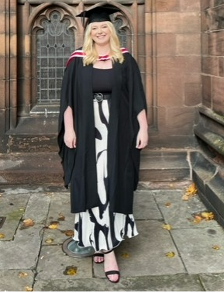
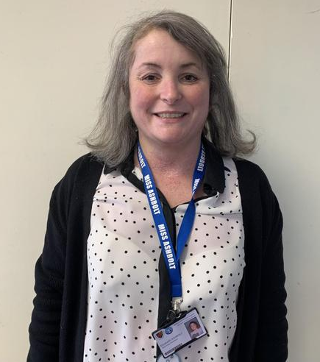
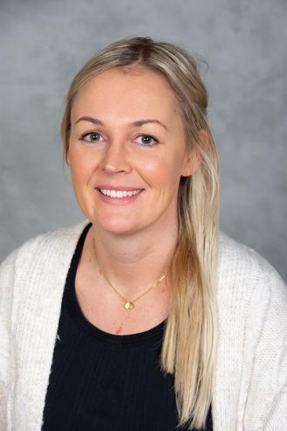
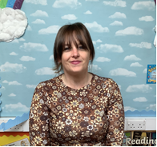
Meet the Team
Mrs Ray Miss Whittingham Miss Thorpe
Executive Headteacher Head of School, DSL & Class Teacher
Early Years Lead
Miss Ashbolt Mrs Shore Mrs Cooper
EYFS TA EYFS TA Secretary

Slide 3
Vision
With wisdom, respect and love, we flourish and shine.
Our School Prayer is:
Let our school be full of love and respect for one another,
Let us have the wisdom to understand our place and flourish as part of God’s creation
But the courage to make the world a better place
With the help of your love may we shine
Amen

Slide 4
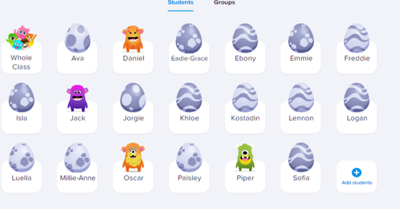
Parents as Partners
We recognise the importance of parents and carers in a child’s developing stages. As a primary care provider you are your child’s first educators and we greatly value any input, opinions and information you can share with us about your child’s learning and progress.
To facilitate this we have a Class Dojo, an online virtual timeline that you are able to assess via a personalised login and passcode. Through this we keep you up to date with things that are happening in and around school. You can also contact us via the messaging service which is checked daily by staff.

Slide 5
Parents as Partners (cont)
We provide many opportunities for parents and carers to take an active part in their child’s education. These include:
• A class assembly
• Educational visits
• Sports events
• Weekly newsletters
• Drop in sessions to view children’s work
Most importantly, our family ethos is central to our school and as such we operate an open door policy where parents are actively encouraged to meet with staff at the earliest opportunity to discuss any concerns.

Slide 6

Preparing your child for school
Your child will be in a class of approximately 30 children. It would make starting school much easier if your child is able to do certain things with a good level of independence. What should he/she be able to do?
Can he/she…
• Put their shoes and socks on themselves?
• Use the toilet independently and ask to go when they need to?
• Tidy up after themselves?
• Recognise their own name? Please tell us if their name is abbreviated in any way.
• Feed himself/herself?
• Share toys and equipment?
• Handle a pencil?
• Sing some nursery rhymes?
• Attempt to count to 10?
• Listen well and follow simple instructions?

Slide 7
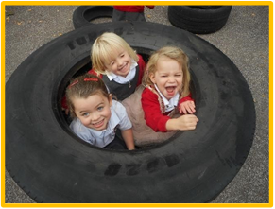
How can I help my child prepare for school?
Encourage your child to be as independent as possible even if it takes far longer for them to get ready.
Get them used to a routine of early to bed and up early. Leave enough time for you and your child to get ready in the morning with as little stress as possible.
Never threaten them with school! Speak about school in positive terms.

Slide 9
The School Day
Morning Procedures
Children are brought into school via the main school gate into the playground. Children are then brought onto Class 1’s yard through the small multi-coloured gate.
Collecting your child
Pick up at 12.00pm – your child will be taken to the main entrance of the school for you to pick up. Please make your way to the main entrance
Pick up at 3.25pm – your child will come out of their classroom and you will need to make your way to the back red door through the multi-coloured gate (the same door as drop off).
First day at school
• Arrive on time • Leave cheerfully • Don’t linger about looking through windows (first day tears are nothing to worry about)

Slide 10
School Dinners
Mrs Williams prepares hot meals for us every day in our school kitchen. A menu is sent home to parents regularly and a copy is displayed on the kitchen notice board. Meals are charged at £2.95 – made payable to Mrs Cooper in the office.
Children may prefer to bring in a packed lunch but please be aware we encourage a healthy eating policy at school.
Children in Reception, Year 1 and Year 2 currently receive free school meals via a government scheme.

Slide 11


Snack
Children currently have a variety of morning snack in
Class 1 including toast, cereal, muffins, crumpets, yoghurts and pancakes. To enable this to happen we ask for a weekly donation of £2 per child. This is paid to the staff in classroom.
Children also have access to the class fruit bowl which is filled daily.
Children under the age of 5 receive a glass of milk for morning snack free via the government scheme. Children over 5 can continue to receive a carton of milk at a cost of £1.00 each week payed via the school office to Mrs Cooper.

Slide 12
Clothes to Wear for School
Our school uniform - red sweatshirt and white polo T-shirt, grey trousers (or shorts) grey skirt (or pinafore) and black shoes.
PE kit of a red t-shirt and black shorts.
Uniform can be ordered through the school website via our uniform link.
Waterproof jackets and winter clothing for cold weather; sun hat and protective clothing in the summer months. We ask that sun cream is applied before the children get to school so that they are ready for the day.
A pair of wellies in school at all times as we have water play out most days. We also recommend children have a change of clothing in school for ‘messy play’ (or accidents) too.

Slide 13
Things to bring to school
• Wellies—we play outside in all weathers!
• Suitable coat—nothing too special as it is likely to get sandy, muddy or wet.
• Spare clothes—just in case we get wet in water play or have an accident.
• Hats, scarves and gloves.
• Sun hats.
• LABELLED Water bottles to be left at school Monday to Friday.
• Book bags
• And during the early days and weeks, if your child has a ‘comforter’ (e.g.teddy bear) we can also find a space for that!

Slide 14

Website

Slide 15

Compass

Slide 16

FOBS
Meet every term to discuss ways of making money to buy resources for the children
FOBS have paid this year:
Art Teacher
PE Teacher
Dance Teacher
Science and DT resources
Coachers
PE kits and equipment
Books
Kindles
Mothers & Fathers Day
Would you like to be part of this?
Next meeting Tuesday 17th September 2024 at 18:30

Slide 17
Transition Dates
Reception
01/7/24 – 9.30 – 10.30 Parents welcome to stay
04/7/24 – 13:00-14:00 Parents welcome to stay
08/7/24 – 9.30 – 11.30 am Children only please
Nursery
02/7/24 – 9:30- 10:30 With Parents
05/7/24 – 13:00-14:00 With Parents

Slide 18
homework
ALL ABOUT BOXES

Slide 19
QUESTIONS?

